Slide 1
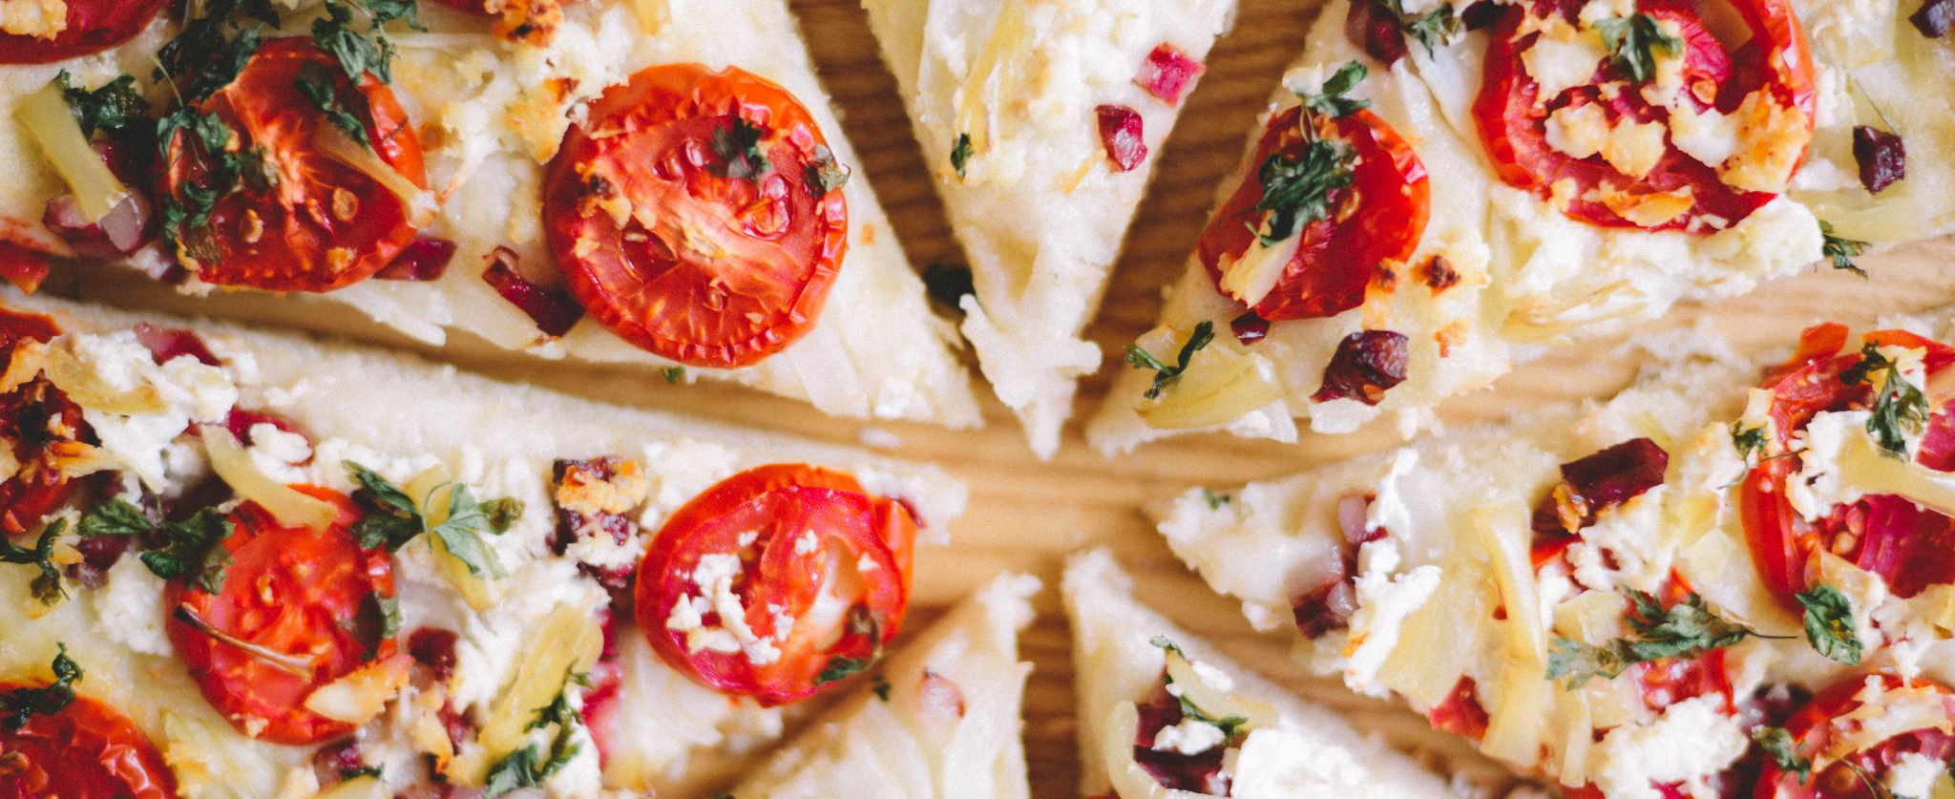
Restaurants and Food Delivery Analysis Sithu Anand

Slide 2
Project Goal
Overall Objective
To systematically identify and assess food delivery services within a specified region, considering factors such as pricing, Yelp ratings, and the availability of vegetarian choices.
To investigate the presence of food delivery deserts in both urban and suburban areas by analyzing the spatial distribution of restaurants and delivery options in relation to urban and rural environments.
To conduct a preliminary analysis aimed at uncovering trends in food delivery, with the potential to categorize these trends by cuisine or food category.
Key questions to address include:
Assessing whether food delivery services are fairly distributed across various geographic areas.
Pinpointing communities in certain locations that lack adequate access to food delivery platforms.
Visualizing the gathered data and identifying correlations among data points.
Examining cost patterns and delivery service options.

Slide 3
Data Sources
Primary data sources
Primary Dataset: Uber Eats USA Restaurant Menus
Source: Kaggle
Citation: Sharma, A. (2021). Uber Eats USA Restaurant Menus [Data set]. Kaggle. https://www.kaggle.com/datasets/ahmedshahriarsakib/uber-eats-usa-restaurants-menus
Content: Contains comprehensive restaurant information including:
Geographic coordinates (latitude/longitude)
Restaurant categories and cuisines
Pricing information
Ratings and reviews
Delivery availability and estimated delivery times
Coverage across multiple major U.S. cities

Slide 4
Data Sources
Official Yelp Dataset Kaggle - This is a comprehensive dataset containing reviews, businesses, users, tips, and check-in data. It covers businesses in North America (USA and Canada).
URL: https://www.kaggle.com/datasets/yelp-dataset/yelp-dataset
· Yelp Review Dataset (700,000 reviews) Kaggle - A large collection focused on reviews.
URL: https://www.kaggle.com/datasets/mexwell/yelp-review-dataset

Slide 5
Data Cleansing
This step aimed to pinpoint data sources, import the data, and clean it to ensure reliable analysis.
DETECT
Spot anomalies, duplicates, and formatting issues in order, restaurant, and delivery datasets.
CORRECT
Address errors by applying standardization, validation rules, and automated correction processes.
PREVENT
Enforce validation at the source to prevent faulty data entry and remove outliers from the dataset.
During this process, I observed some duplicate entries for the same order as well as incomplete data in the sources I used.

Slide 6
Data Cleansing
The dataset was cleaned using the following procedure.
Step 1: Load and Examine the Raw Data
Begin by loading the restaurants and menus datasets from the downloaded files, then merge them into a unified dataset containing restaurant names, addresses, city, state, zip codes, reviews, and other relevant information.
Preview a sample of the data (e.g., using .head() or .sample()) to understand the available columns.
Identify any missing values, inconsistencies, NaN entries, or duplicate records.
Step 2: Standardize Column Names & Data Types
Adjust column names by converting them to lowercase, replacing spaces or special characters, and ensuring consistent naming conventions.
Assign proper data types as follows:
IDs (such as restaurant-id or item-id) → strings
Prices → numeric (float)
Categorical variables (like cuisine type or item category/section) → categorical or string

Slide 7
Data Cleansing cont…
Step 3: Clean and Standardize Key Fields
Restaurant-level fields: Standardize cuisine categories by converting variations like “Mexican”, “mexican”, and “MEXICAN” to a consistent format such as “Mexican.”
Menu-item fields: Clean item names and descriptions by removing extra spaces and normalizing capitalization. Address or remove items missing names or prices as needed.
​Step 4: Manage Missing or Invalid Data
Identify entries lacking essential information, such as restaurants without valid locations, menu items without prices, or blank item names.
Establish a policy for each column: either remove these entries, impute missing values, or flag them. For example:
Menu items without prices might be dropped or labeled as “price missing,” depending on the analysis goals.
Restaurants missing cuisine data could be tagged as “unknown”.

Slide 8
Data Cleansing cont…
Step 5: Structuring Relationships & Eliminating Duplicates
Since the dataset includes both restaurant-level and menu-item–level information, it's important to create a customized dataset.
​
Step 6: Data Validation & Quality Checks
After cleaning and transforming:
Check for invalid prices (negative, zero, extremely high outliers).
Step 7: Persist Cleaned Data for Analysis
Save the cleaned as csv.
Step 8: Merge with External Data — For Enrichment
If you have or can get additional data sources, merging can add insight:
Demographic / geographic data by city/ZIP. Identify Metropolitan area
​

Slide 9
Data Cleansing cont…
Step 9: Identifying Region based on State and Metropolitan Statistical Area
Identify and organize the restaurant location and identify the nearest metro area.
​
​

Slide 10
Basic data after Data Cleansing
id | name | score | category_x | price_range | lat | lng | zip_code | restaurant_id | category_y | price | price_level
63 | Sol Azteca | 4.6 | Mexican, Seafood | $ | 33.4261627 | -86.7939687 | 35216 | 32728 | Picked for you | 8.95 USD | 1
63 | Sol Azteca | 4.6 | Mexican, Seafood | $ | 33.4261627 | -86.7939687 | 35216 | 32728 | LO FAVORITO | 8.95 USD | 1
63 | Sol Azteca | 4.6 | Mexican, Seafood | $ | 33.4261627 | -86.7939687 | 35216 | 32728 | Botanas | 8.95 USD | 1
73 | Rice Bowl | 4.3 | Asian, Chinese, Comfort Food | $ | 33.51169 | -86.78845 | 35233 | 47 | Picked for you | 11.5 USD | 1
73 | Rice Bowl | 4.3 | Asian, Chinese, Comfort Food | $ | 33.51169 | -86.78845 | 35233 | 47 | Pick a Base | 11.5 USD | 1
73 | Rice Bowl | 4.3 | Asian, Chinese, Comfort Food | $ | 33.51169 | -86.78845 | 35233 | 796 | Starters | 2.19 USD | 1
73 | Rice Bowl | 4.3 | Asian, Chinese, Comfort Food | $ | 33.51169 | -86.78845 | 35233 | 4352 | Old Fashions | 7.99 USD | 1
73 | Rice Bowl | 4.3 | Asian, Chinese, Comfort Food | $ | 33.51169 | -86.78845 | 35233 | 8234 | Sides | 2.99 USD | 1
73 | Rice Bowl | 4.3 | Asian, Chinese, Comfort Food | $ | 33.51169 | -86.78845 | 35233 | 8278 | Picked for you | 17.94 USD | 1
73 | Rice Bowl | 4.3 | Asian, Chinese, Comfort Food | $ | 33.51169 | -86.78845 | 35233 | 8278 | Bowls &amp; Salads | 17.94 USD | 1

Slide 11
Data Analysis
The data analysis covers the following areas
​
Basic Analysis
Count of restaurants, menu items, and cuisines.
Price distribution of menu items (mean, median).
Distribution of calories, number of items per restaurant, and related metrics.
Price ranges categorized by cuisine or food type.
Price and Item Comparisons
Comparison between the most expensive and least expensive cuisines.
Price variations for similar items across different restaurants.
Correlation between calorie content and price. ​
Restaurant-Level Insights and Diversity
Number of menu items offered by each restaurant.
Types of categories available (e.g., Burgers, Pizza, Mexican).
Typical price ranges for each restaurant.
​

Slide 12
Analysis cont…
4. Create composite metrics:
Restaurants per capita: Normalized restaurant count by population
5. Potential Visualizations Cuisine diversity index: Shannon diversity or Simpson's index applied to cuisine types
Average delivery radius: Mean distance from restaurants to delivery areas
Service density score: Weighted metric combining count, diversity, and delivery speed
Accessibility index: Composite score incorporating multiple access dimensions
Top 20 cuisines (bar chart)
Menu price distribution (histogram)
Cuisine popularity by state (geographic heat map)
Ingredient frequency word cloud

Slide 13
Basic Analysis - Top 20 categories

Slide 14
Analysis cont…
6. Additional Visualizations
Top 20 cuisines (bar chart)
Menu price distribution (histogram)
Calories vs. price scatter plot
Cuisine popularity by state (geographic heat map)
Ingredient frequency word cloud

Slide 15
Analysis cont…
7. Distribution by Region visual map
Most popular cuisines per state.
Average price differences across states or cities.
Which cities have the most menu diversity?
8. Simple Density Threshold Baseline:
Method: Classify areas with < X restaurants per square mile as deserts
Purpose: Compare against naive approach to demonstrate value of sophisticated methods
Comparison: Our multi-method approach should outperform simple thresholding

Slide 16
Analysis cont…
9. Regional Food Trends
Most popular cuisines per state.
Average price differences across states or cities.
Which cities have the most menu diversity?

Slide 17
Clustering Analysis
10. Clustering Analysis
Group restaurants according to price range, calorie content, and cuisine category.
Group menu items based on their ingredients.
​
11. Recommendation Analysis
Suggest items comparable to a specific dish using NLP embeddings.
Suggest restaurants tailored to cuisine preferences.
​

Slide 18
Clustering Analysis cont…
12. Spatial Clustering Analysis
The library identified Scikit-learn DBSCAN Implementation
DBSCAN (Density-Based Spatial Clustering of Applications with Noise):
Purpose: Identify geographic clusters of high and low restaurant density
Desired Output: Classification of areas into dense delivery zones vs. sparse/desert zones

Slide 19
Clustering by locations based on Geographic location

Slide 20
Conclusion
Does the data offer enough evidence to conclude that delivery menus in the U.S. are primarily dominated by a few major cuisines, with pricing varying based on cuisine type and city, and a distinct separation between fast-casual and specialty restaurants?
Does the data support the statement that clustering and category analysis identify natural food groupings?
Even without predefined categories, menu items tend to group into clusters such as:
Burgers & sandwiches
Pizza & pasta
Asian noodles & rice dishes
Salads & bowls
Desserts & beverages

